Slide 1
Simulation Study of Droplet formation in T Junction
CLL770 – Term Project
Mitanshu Kansal (2020CH70180)
Lalwala Taukir Mohamad (2020CH70174)

Slide 2
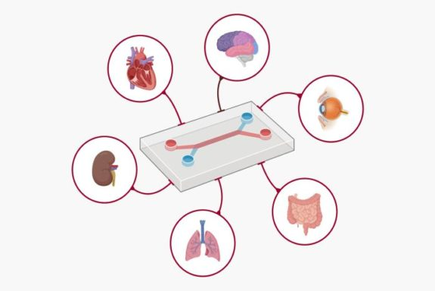
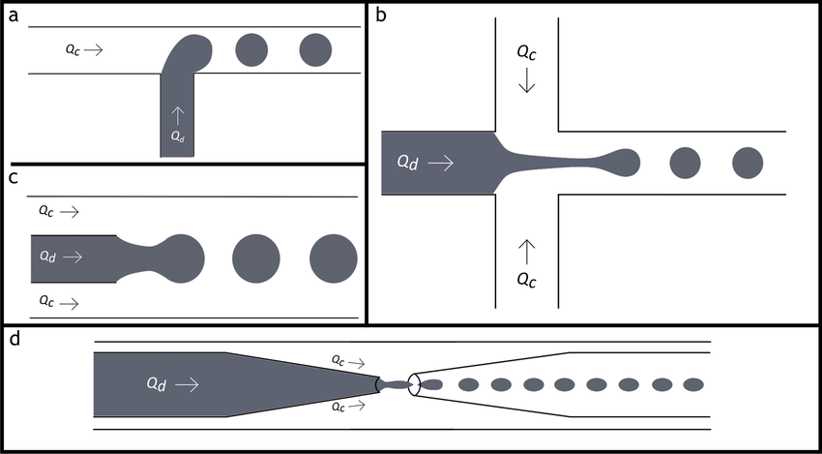
Introduction
Microfluidics is a cutting-edge field which manipulates fluids at the microscale to achieve precise control over physical and chemical process.
The field play a vital role in applications such as:
Drug delivery systems
Diagnostic tools for medical research
Fig: Lab on a chip[1]
Droplet formation is a core mechanism in microfluidic systems enabling generation of uniform droplets for chemical reactions.
It involves interaction of two immiscible fluids usually in at a junction
Fig: Droplet formation[1]
[1]: Filimonov, R., Wu, Z., & Sundén, B. (2021). Toward computationally effective modeling and simulation of droplet formation in microchannel junctions. In Chemical Engineering Research and Design (Vol. 166, pp. 135–147). Elsevier BV. https://doi.org/10.1016/j.cherd.2020.11.010

Slide 3

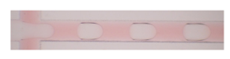
Research Paper overview
Simulate droplet formation in T-Junction microfluidic channels
Study conducted on key parameters:
Flowrate Ratio
Viscosity
Interfacial Tension
Contact Angle
Simulation validated against experimental data
Fig.: Droplet Formation from Simulation[1]
Fig.: Droplet Formation from Experiment[1]
[1]: Filimonov, R., Wu, Z., & Sundén, B. (2021). Toward computationally effective modeling and simulation of droplet formation in microchannel junctions. In Chemical Engineering Research and Design (Vol. 166, pp. 135–147). Elsevier BV. https://doi.org/10.1016/j.cherd.2020.11.010

Slide 4
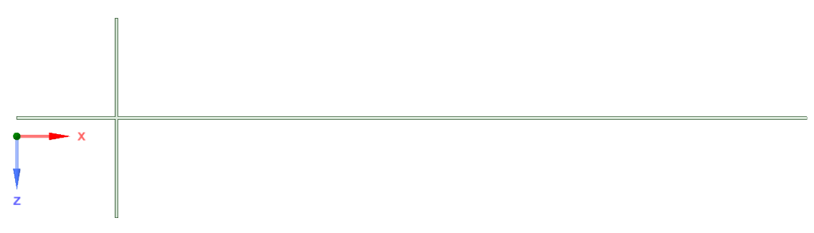
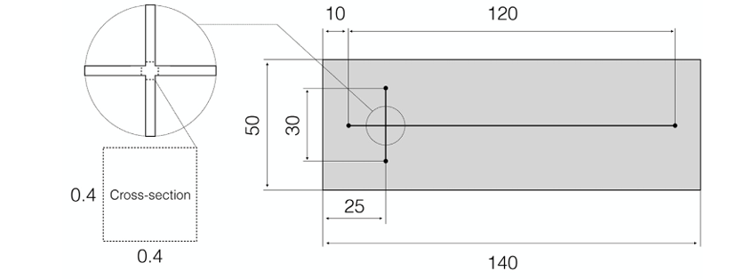
Details on Simulation Done
Geometry Generated using the dimensions provided in research paper using Spaceclaim
Fig.: Schematic of Geometry[1]
[1]: Filimonov, R., Wu, Z., & Sundén, B. (2021). Toward computationally effective modeling and simulation of droplet formation in microchannel junctions. In Chemical Engineering Research and Design (Vol. 166, pp. 135–147). Elsevier BV. https://doi.org/10.1016/j.cherd.2020.11.010

Slide 5
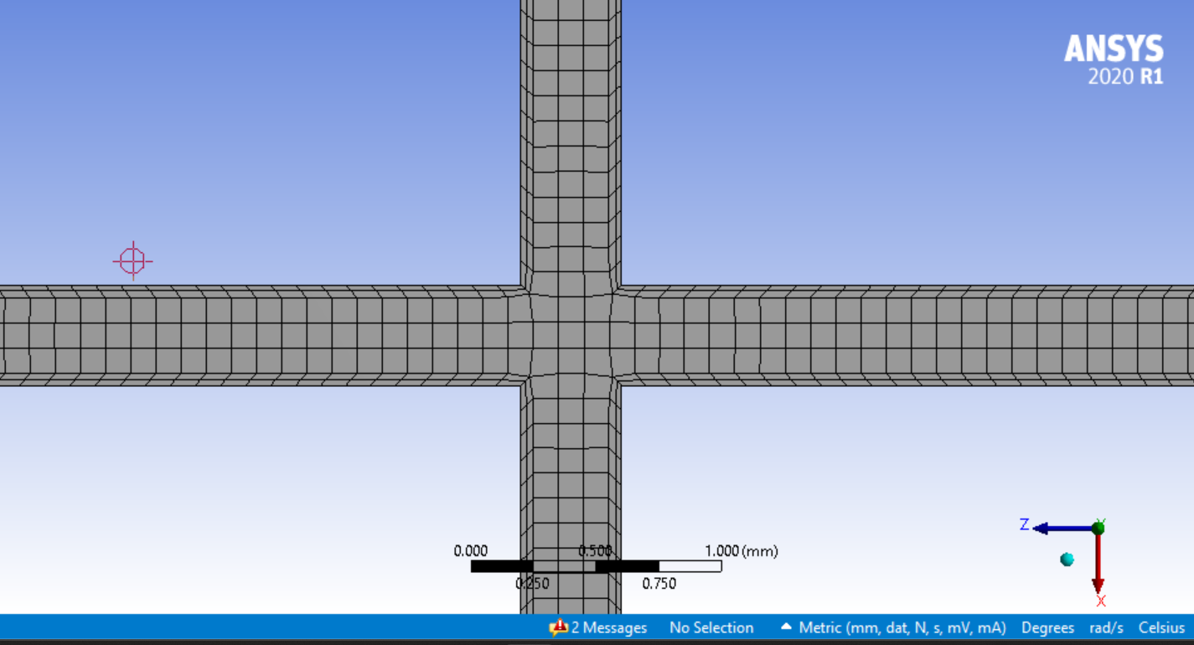
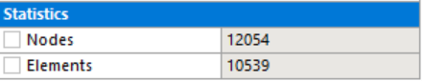
Details on Simulation Done
Generate Mesh with Element size of 0.1 mm.
Table: Statistics of the mesh generated

Slide 6
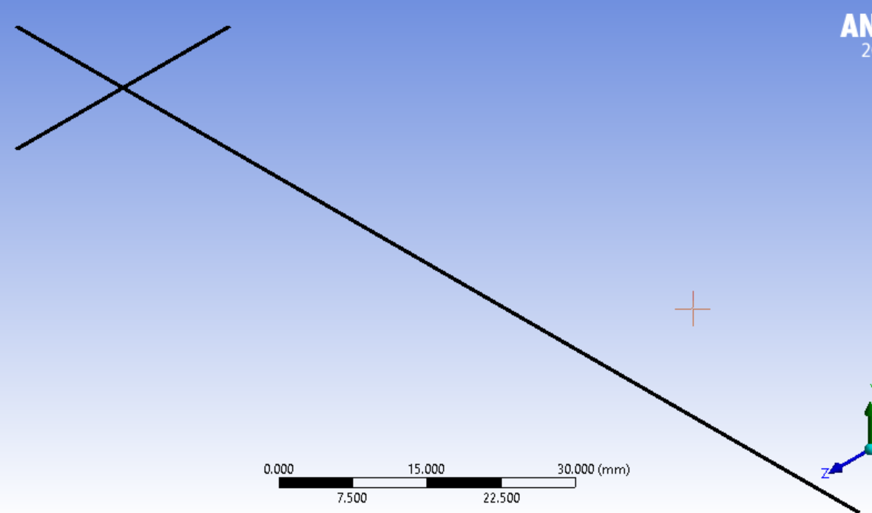
Details on Simulation Done
Fluid used through the Microchannel:
Water liquid
Density: 998.2 kg/m²
Viscosity: 0.001003 kg/m-s
Oil
Density: 1000 kg/m²
Viscosity: 0.00671 kg/m-s
Contact Angle between the fluids: 135°
Velocity of Water = 0.01 m/s
Velocity of Oil = 0.01m/s

Slide 7
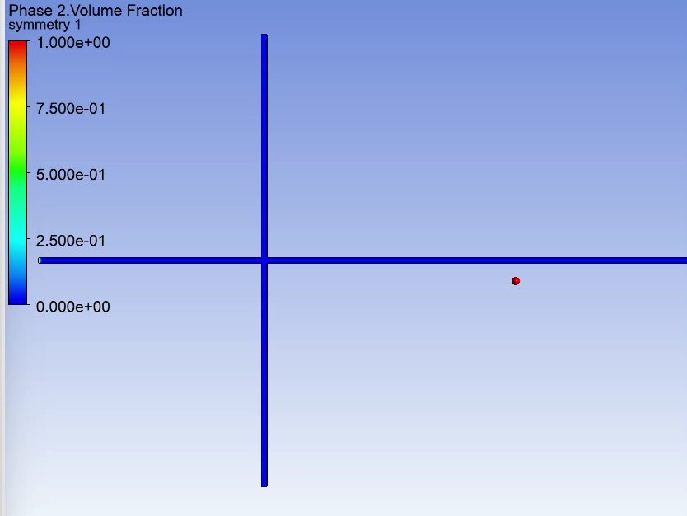
Simulation of droplet formation

Slide 8
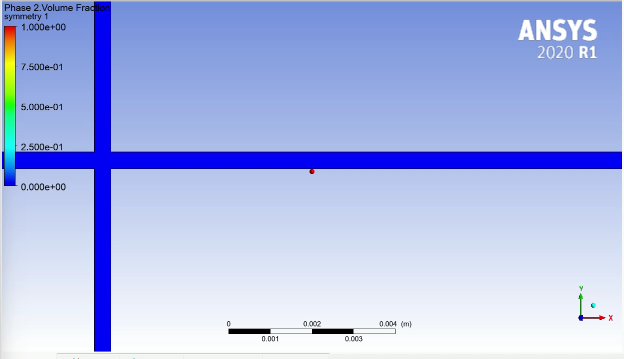
Simulation of droplet formation

Slide 9
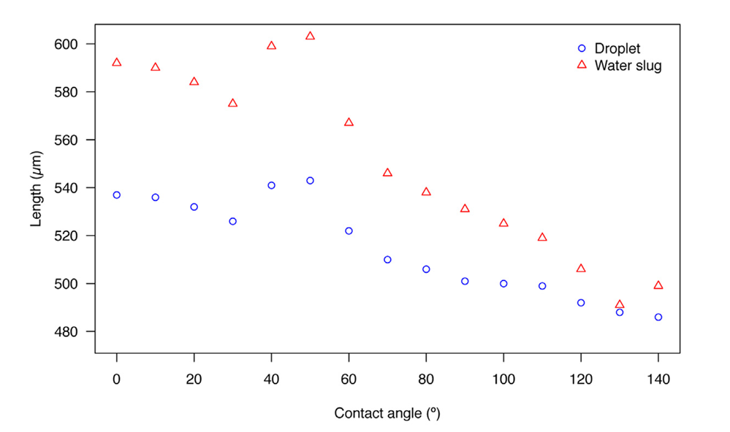
Literature Results
Fig.: Droplet and Water Slug length vs. Contact Angle [1]
[1]: Filimonov, R., Wu, Z., & Sundén, B. (2021). Toward computationally effective modeling and simulation of droplet formation in microchannel junctions. In Chemical Engineering Research and Design (Vol. 166, pp. 135–147). Elsevier BV. https://doi.org/10.1016/j.cherd.2020.11.010

Slide 10
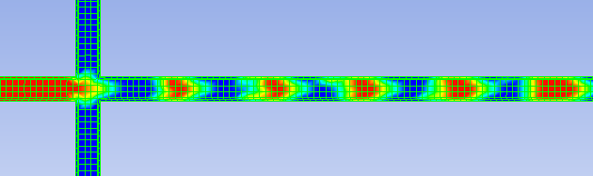
Results and conclusion
0.4mm
0.64mm
0.8mm
Our Results:
Droplet Length = 0.64mm
Water Slug Length = 0.8 mm
From Literature [1]:
Droplet Length = 0.48mm
Water Slug Length = 0.49 mm
[1]: Filimonov, R., Wu, Z., & Sundén, B. (2021). Toward computationally effective modeling and simulation of droplet formation in microchannel junctions. In Chemical Engineering Research and Design (Vol. 166, pp. 135–147). Elsevier BV. https://doi.org/10.1016/j.cherd.2020.11.010

